Slide 1
Attendence Management System

Slide 2
CONTENTS :
Chapter | Titleof theChapter/ ChapterName | PageNo.s
A | ABSTRACT | 6
I | AMSIntroduction | 9-10
II | WebsiteCreation | 11-16
III | Dockers | 17-21
IV | RDS | 22-24
V | Heroku | 25-30
B | References andAppendix | 31

Slide 3
ABSTRACT :
Student attendance management system deals with the maintenance of the student's attendance details. It generates the attendance of the student on basis of presence in class. It is maintained on the daily basis of their attendance.

Slide 4
AMS Introduction :
An attendance system allows to add the attendance of the employee who is present on that day. The user has to login and swipe their identity card to mark their attendance. As the card has been swiped, the details like id number, date, in-time, out-time are saved in the database. The database will be stored into the azure cloud which will form a connection between application and cloud server via internet. With the in-time and out-time data stored in cloud, the admin can calculate the working hours of the employees. The employees can view his personal details, attendance,
in-time or out-time, total working hours after he/she logs into the system. This data is retrieved from the cloud database and can be accessed any time by the employee and the admin. The admin of the system can add new employee by registering the new employee and filling up their registration details. The admin is authorized to view the records of all the employees. This system allows to keep up to date record of the employee. As, the project files and a database file will be stored into the Azure cloud, the project will be accessed in the web browser through Azure link.

Slide 5
CREATION OF WEBSITE :
Web based based attendance management system has replaced the previous paper based premises of attendance management system. The new system can now handle large number of attendees and events over large networks. Web based attendance system is easy to use and yet very powerful attendance management system that has a firm grip over schools, laboratories, committees, offices, business organizations etc.
The main feature of Web based attendance management system is the System Server that has been made centralized for all the branches scattered over different geographical regions. To login into the server using web based attendance management system, users can create multiple password protected event manager accounts which can further create unlimited events and user accounts.
In short, web based attendance management system provides users an identification along with a password that allows them to login to their accounts from anywhere anytime.
This web based Attendence Management System has been created for both System Administrator and Faculty. Faculty can access to the website through necessary login crediantials and the faculty can mark attendance to the students of different Departments , Classes , Courses in their respective Registration codes.
This web based Attendence Management System is quite easy and flexible to use for both the System Administrator and Faculty. Through this System Faculty can Print the Attendence Report of each and every Student of any Department they wish.

Slide 6
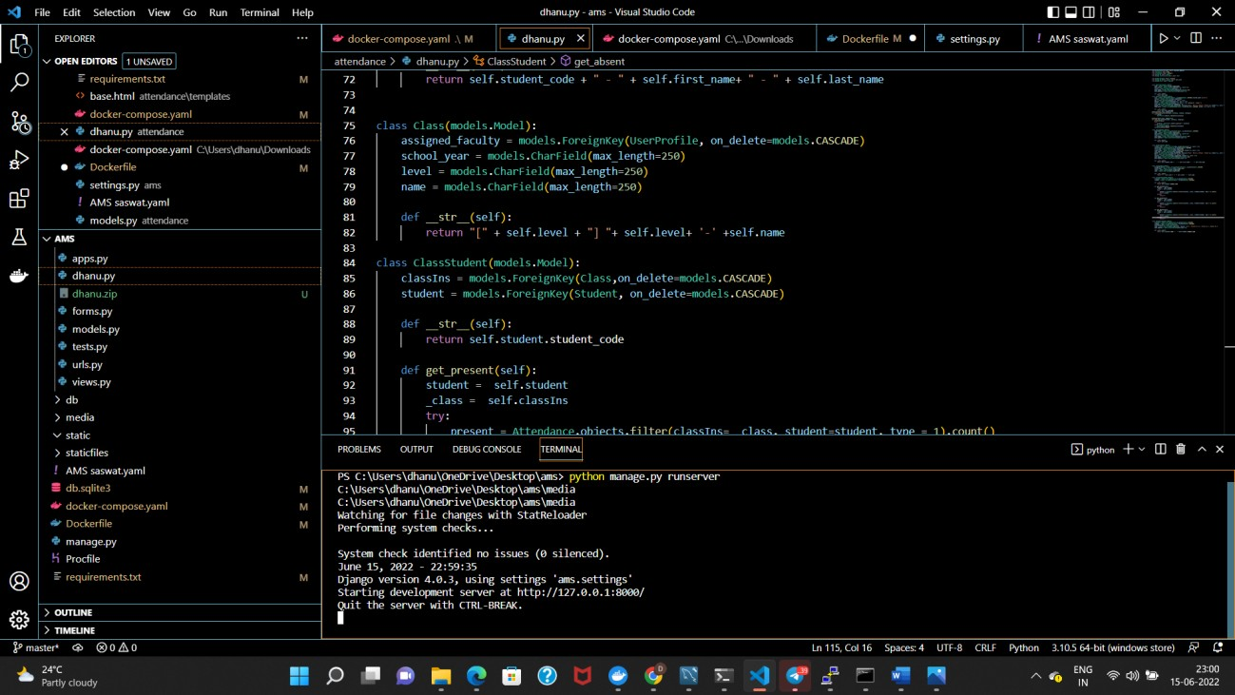
Snapshot of Visual Studio:
Website.: https://attendence-management- system5.herokuapp.com/login?next=/.
This is the link of Attendence management website for both System Administrator and Faculty. Both System
Administrator and Faculty can access this site with appropriate login crediantials.

Slide 7
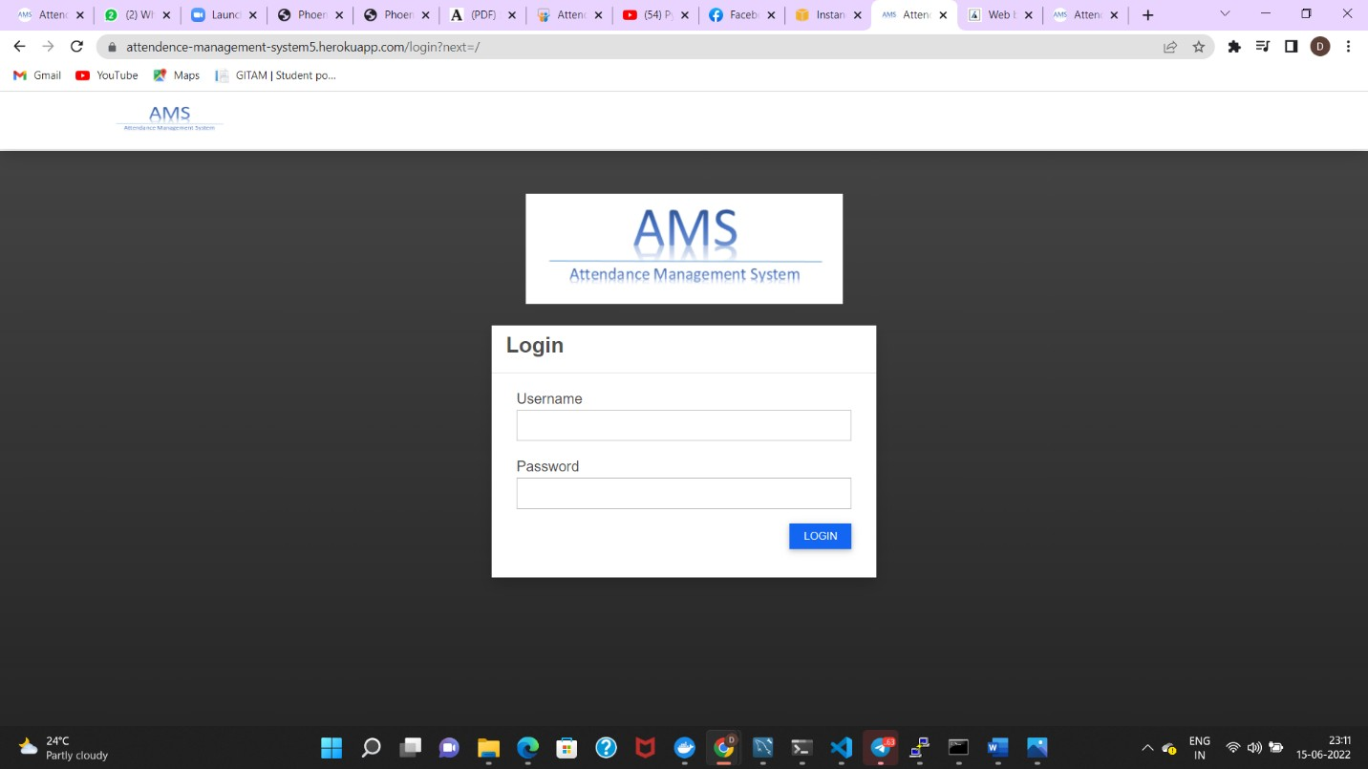
Snapshots of Website ( System Administrator ) :
This is the Login page of our Attendence Management System. Here System Administrators can access with
their login crediantials

Slide 8
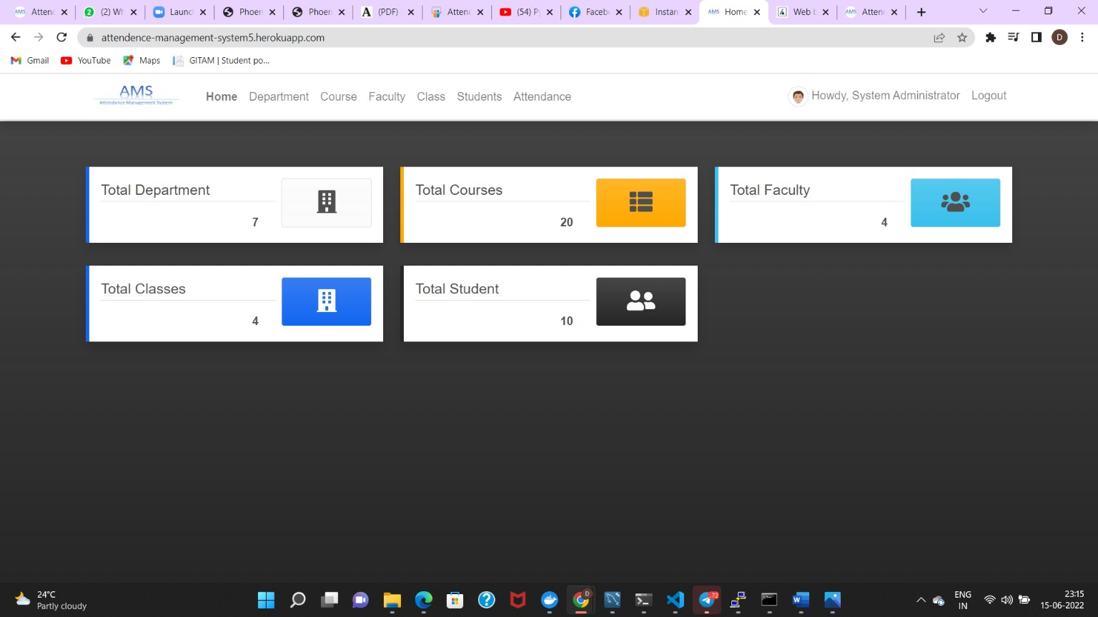
This is the System Administrator Home page to view the attendance of students by going to respective Departments , Courses and Classes.
.

Slide 9
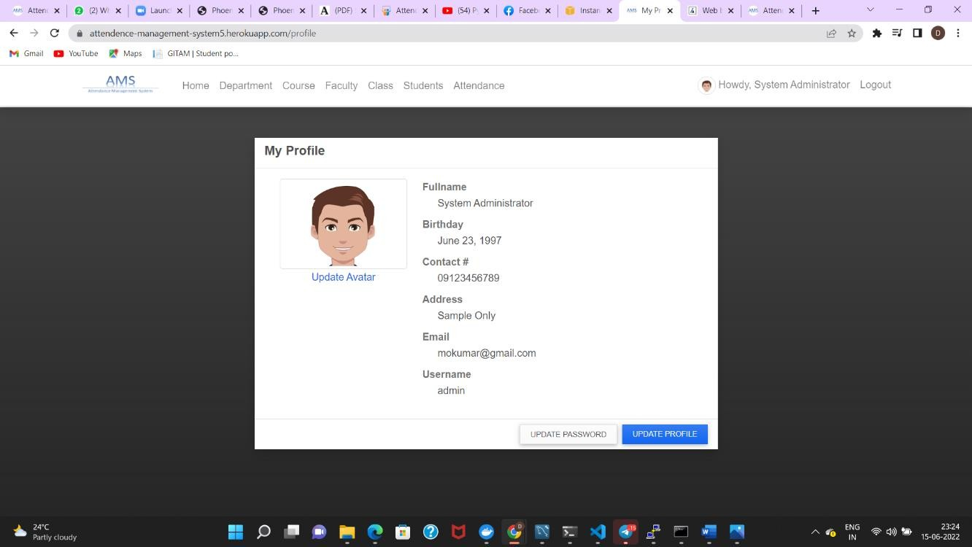
This above snapshot is the is the Profile details of System Administrator he/she can edit or update their details.

Slide 10
Snapshot of Website ( Faculty ) :
This is the Login page of our Attendence Management System. Here Faculty can access with their login crediantials.

Slide 11
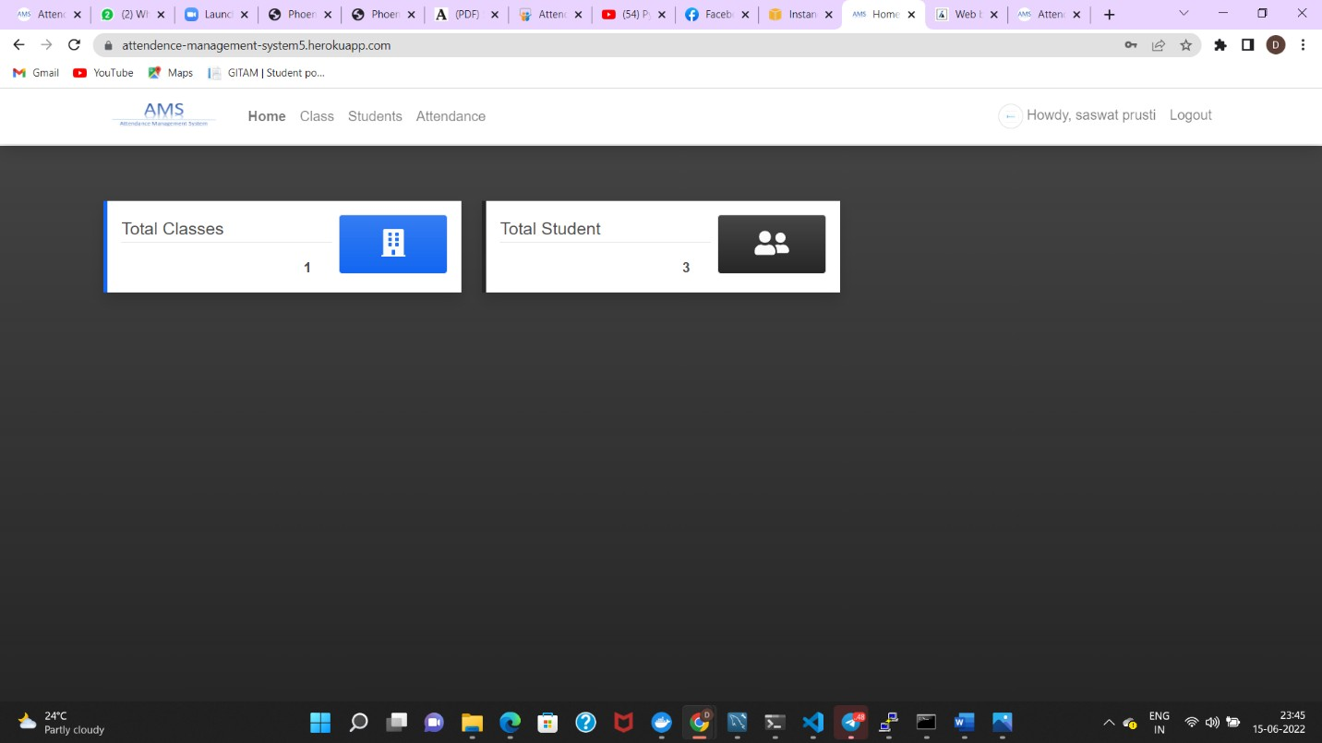
This is the Faculty Home page to view and mark the attendence of students by going to respective Classes. And here the faculty can also Print the Attendence report of any student.

Slide 12
DOCKER :
Docker is an open-source containerization platform.
It is a platform for building, deploying, and managing containerized applications.
Developers can create containers without Docker, but the platform makes it easier, simpler, and safer to build, deploy and manage containers.
Docker is essentially a toolkit that enables developers to build, deploy, run, update, and stop containers using simple commands and work-saving automation through a single API.
In other words, we can easily say that Docker is an alternative of a Virtual Machine.
Using Docker, we can also run Linux platform OS like Ubuntu, CentOS and many more within our Windows System.
Docker images contain executable application source code as well as all the tools, libraries, and dependencies that the application code needs to run as a container.
When you run the Docker image, it becomes one instance (or multiple instances) of the container.

Slide 13
Continued...
•Multiple Docker images can be created from a single base image, and they’ll share the commonalities of their stack.
•Docker images are made up of layers, and each layer corresponds to a version of the image.
•Whenever a developer makes changes to the image, a new top layer is created, and this top layer replaces the previous top layer as the current version of the image
•Previous layers are saved for rollbacks or to be re-used in other projects.
•Docker containers are the live, running instances of Docker images. While Docker images are read-only files, containers are live, ephemeral, executable content. Users can interact with them, and administrators can adjust their settings and conditions using docker commands.

Slide 14
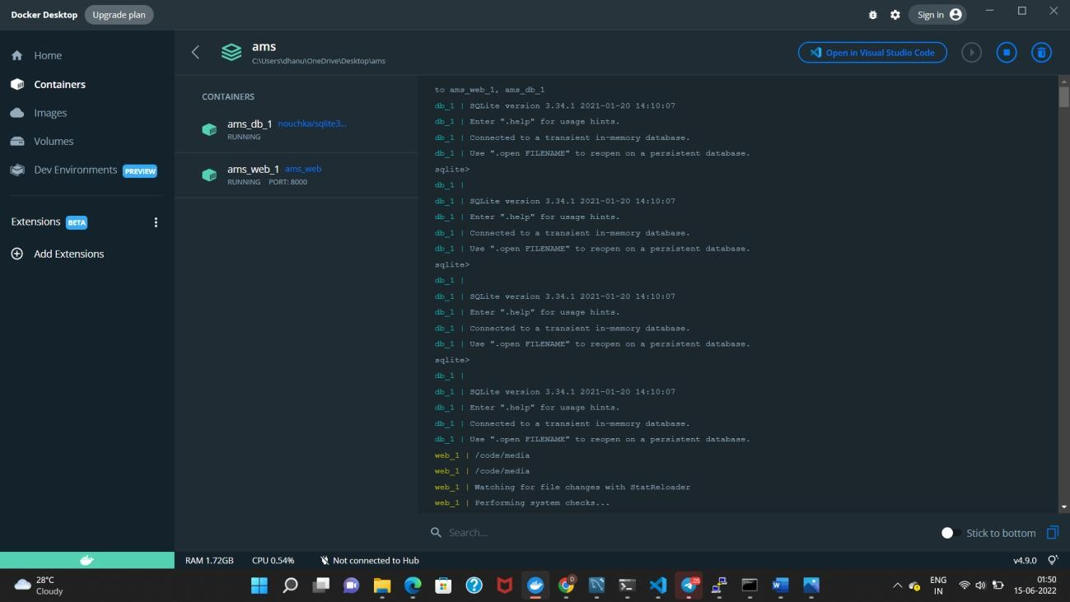
In the Docker app AMS is our main container and it is in the running state. In the main container AMS there are 2 sub containers AMS web and AMS sqlite and they both are in also running state.

Slide 15
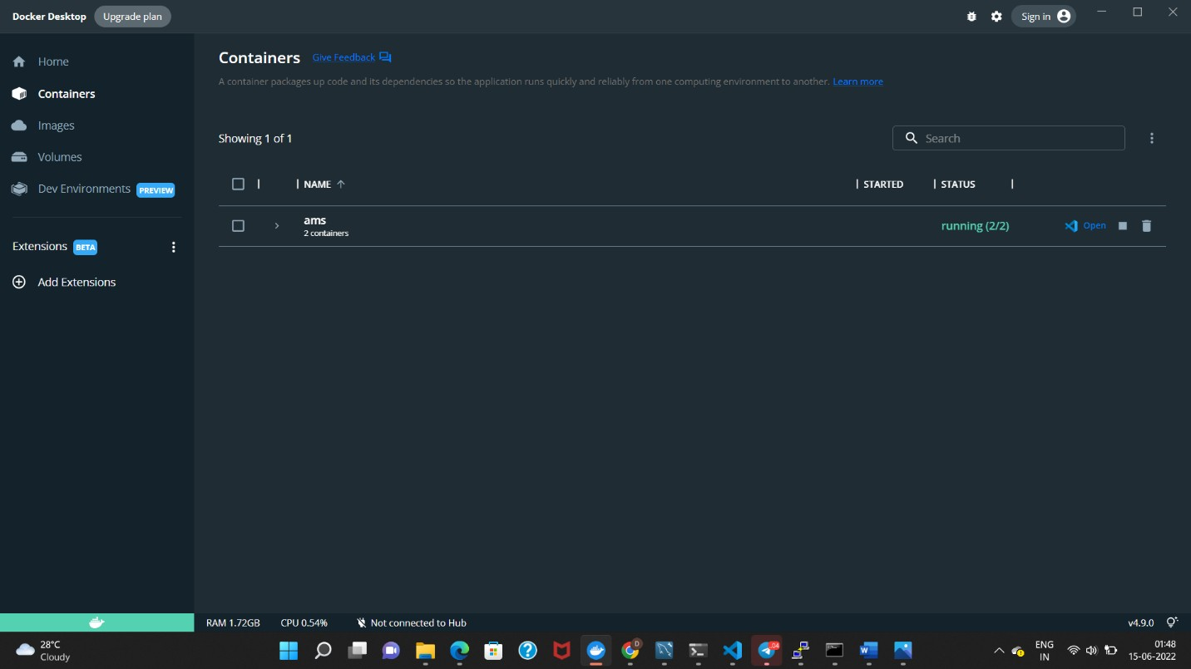
In the Docker app AMS is our main container and it is in the running state. In the main container AMS there are 2 sub containers AMS web and AMS sqlite and they both are in also running state.

Slide 16
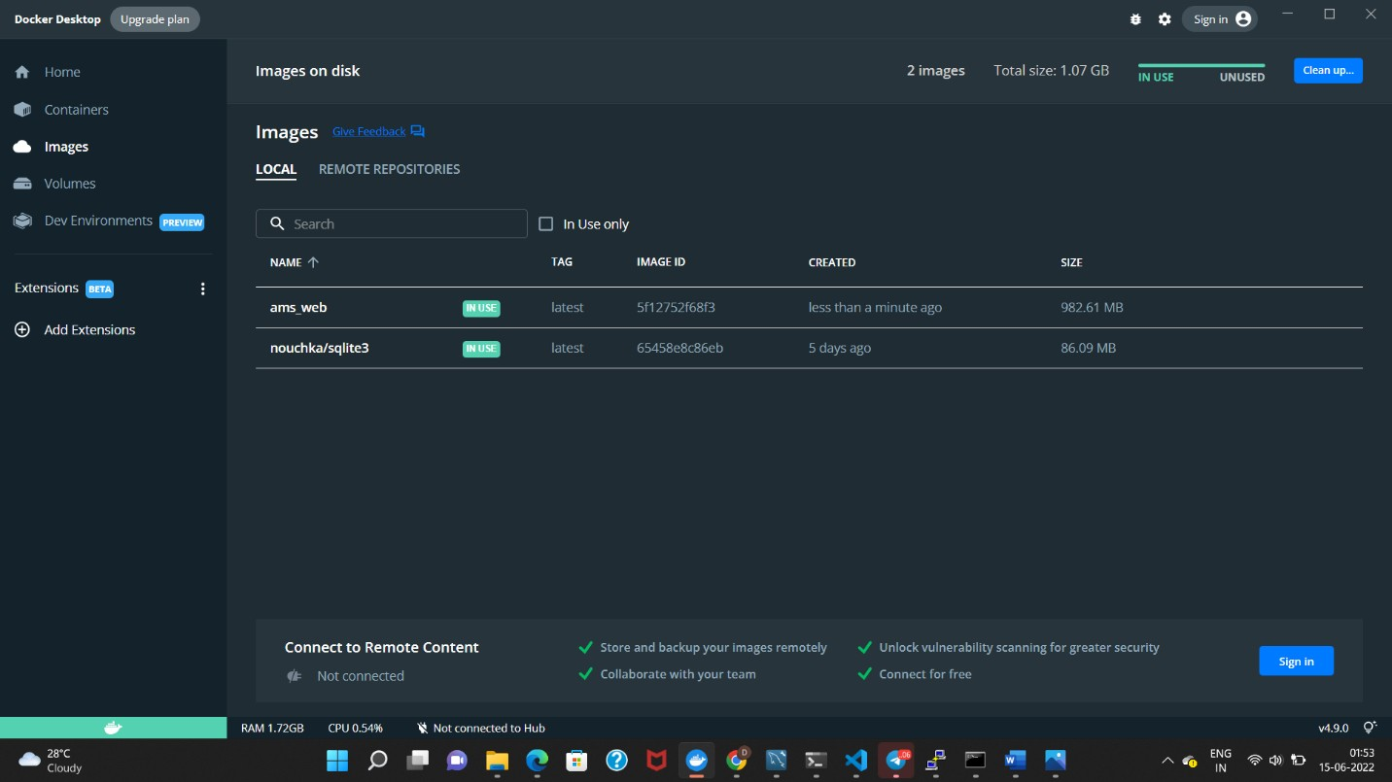
.

Slide 17
While in the Local there are 2 images which are remote repositories 1st is AMS web( Front-end ) and 2nd is AMS sqlite ( Back-end) both are in use in the Dockers app. In this entire process we seen that the Dockers is connected with the Visual studio with a command. docker-compose up -d

Slide 18
Heroku :
Heroku is a container-based cloud Platform as a Service (PaaS). Developers use Heroku to deploy, manage, and scale modern apps. Our platform is elegant, flexible, and easy to use, offering developers the simplest path to getting their apps to market.
Heroku is fully managed, giving developers the freedom to focus on their core product without the distraction of maintaining servers, hardware, or infrastructure. The Heroku experience provides services, tools, workflows, and polyglot support—all designed to enhance develop productivity

Slide 19
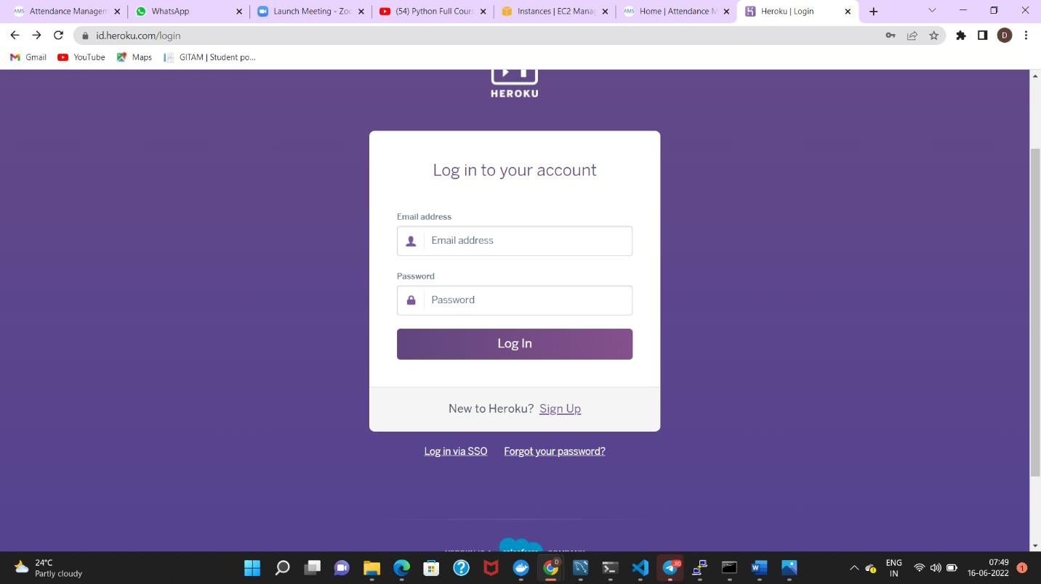
Snapshots of Heroku:
This is the Login page of Heroku. Here the user can access the site through login crediantials

Slide 20
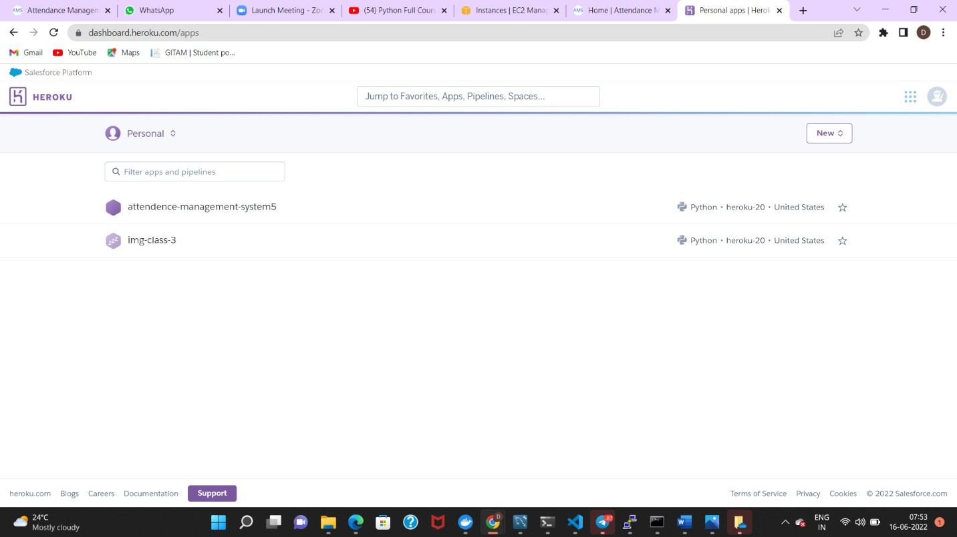
Continued...

Slide 21
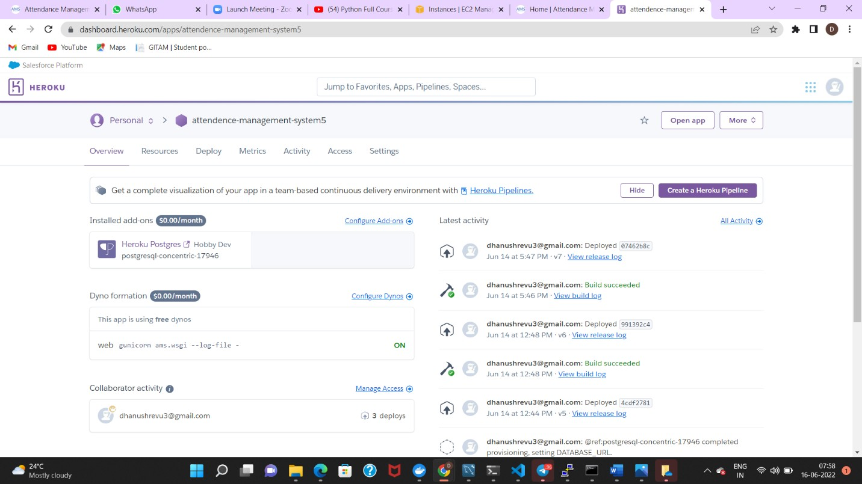
Attendence Management System and Image class are the 2 containers. In this main file the necessary things has been initialized and deployed.

Slide 22
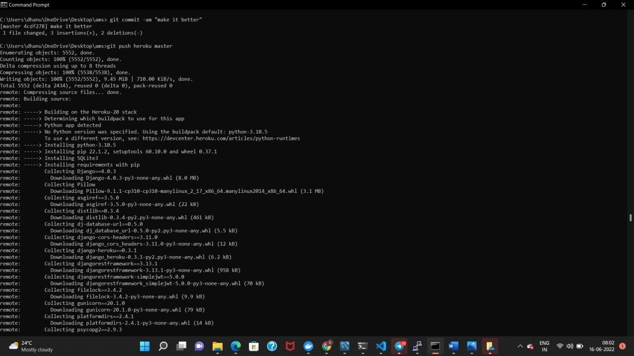
Snapshot of Command Prompt:

Slide 23
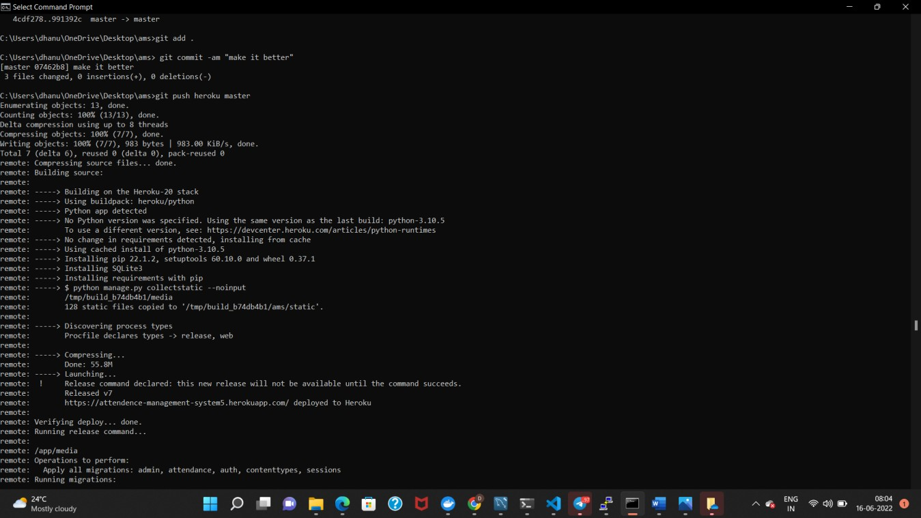
Continued...

Slide 24
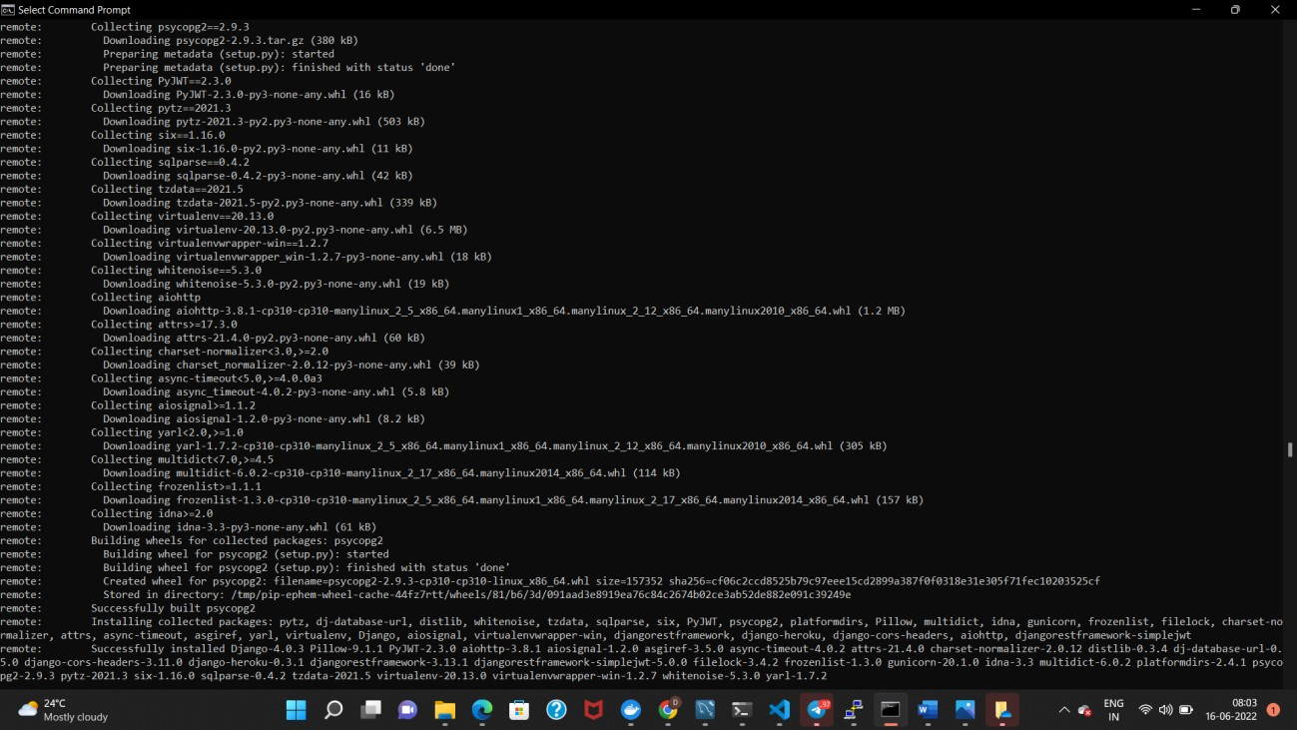
Continued...

Slide 25
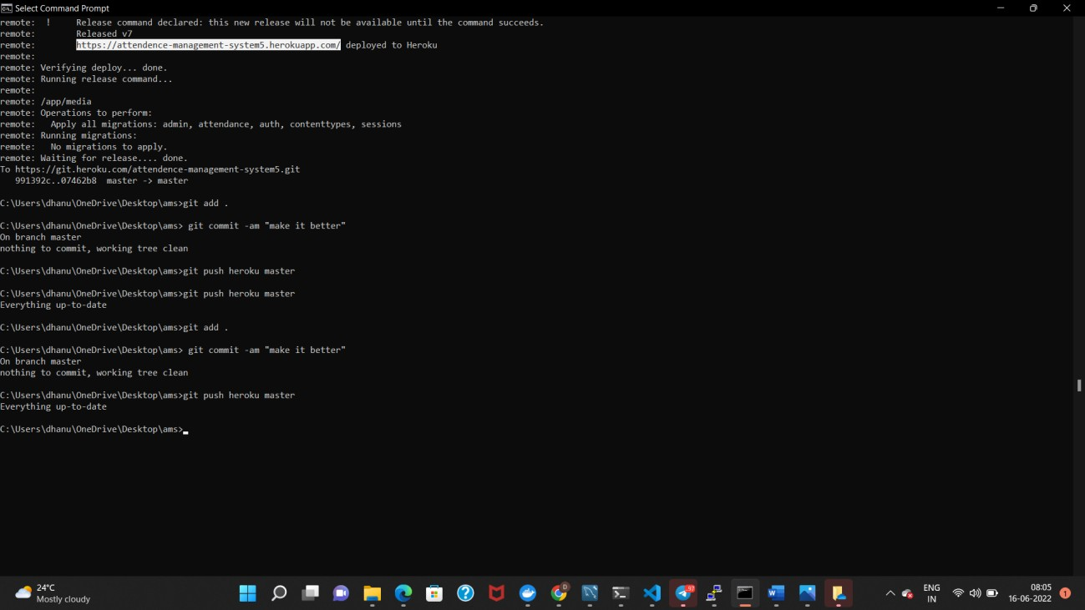
Continued...

